Slide 1
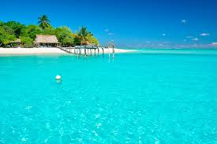
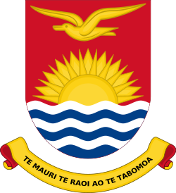
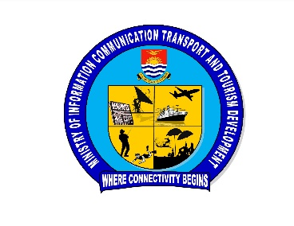
16th Meeting of the South West Pacific Hydrographic Commission National Report by Republic of Kiribati
Notes:
Good afternoon, my name is Tion Uriam, and I am very happy to be here for the first time attending the 16th South West Pacific Hydrographic Commission. I’ll be presenting today on behalf of the Kiribati team. Recenty established a hydrographic Unit, however, there has been many other activities in the maritime sector that is significant with regards to improving maritime safety and marine environmental protection

Slide 2
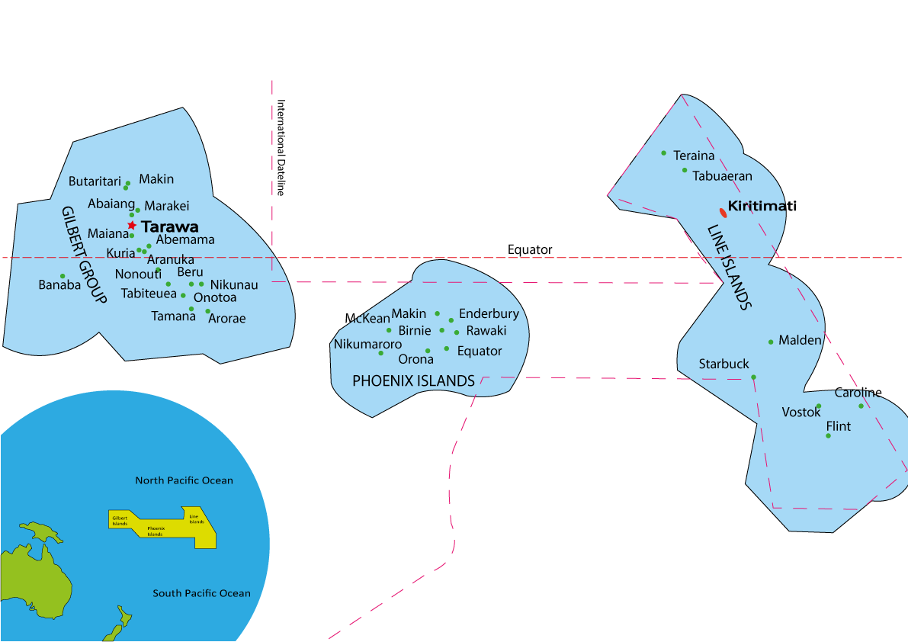
Context map
Notes:
- Just to highlight the extent of the area that is covered by Kiribati

Slide 3
Relevant activities
SOUTH PACIFIC COMMUNITY (SPC)
Establishment of women association in maritime sector
Training on data collection (Domestic vessels) – MTCC Pacific
PIDSS Support – Safe Operational Plan (SOP)
Kiribati Marine Legal Officer – Work attach with SPC’s maritime legal experts – drafting of maritime laws and regulation
Notes:
Establishment of women in maritime association – there was none previously – good means
Marine Surveyors – MTCC Pacific - MTCC – Maritime Technology Corporation Centre (Suva, Fiji)
PIDSS – Pacific Island Ship Safety (SPC) – Safety Operational Plan

Slide 4
Relevant activities
GOV’T OF NEW ZEALAND:
UNDER THE PACIFIC MARITIME SAFETY PROGRAMME (PMSP- PHASE 2)
Delivery of Maritime Safety Awareness – to the Community
Completion of Corrective Action Plan (CAR) from IMSAS Audit Findings and Observations
Wooden Boat Survey Start-Up Training – MARITIME NZ
Search And Rescue Training including (Live Operation – Aerial and Surface Rescue Exercise) – NZ Maritime Rescue Coordination Center
Notes:
Funded by New Zealand
Safety awareness concerning mariners – fishing communities – visited individual communities – addresses issues concerning safety, in particular, preparations to prevent the number of lost of sea cases
Audit done in 2017 - Findings from IMO – we are now in the processing of going through the corrective plan
Marine Surveyors – current issue – our marine surveyors were not trained to survey wooden boats – used to checking steel boats –
Marine Division, Police, Fisheries on search and rescue

Slide 5
Relevant activities
European Union (EU) and New Zealand (NZ):
Kiribati participation at IMO - Intersessional Working Groups (ISWG) and MEPC Meetings on Green House Gas (GHG) Emissions reductions

Slide 6
Relevant activities
Central Pacific Shipping Community – SPC as Secretariat
(Republic of Marshal Islands, Republic of Nauru, Tuvlau, Kiribati, Wallis and Futuna)
Good collaboration between islands
Reduced Freight Rate from one of the EAC License Holders
Notes:
CPSC – Central Pacific Shipping Community
EAC

Slide 7
Relevant activities
Trade facilitation 3 day seminar in Kiribati (IMO and SPC)
NSCV CODE Surveyors Training – Australian Maritime Safety Authority (Sydney Australia)
IMSAS (IMO) AUDIT TRAINING – Maritime NZ (Wellington)
Notes:
Trade facilitation seminar
National Standard for Commerical Code
IMO Member State Audit Scheme

Slide 8
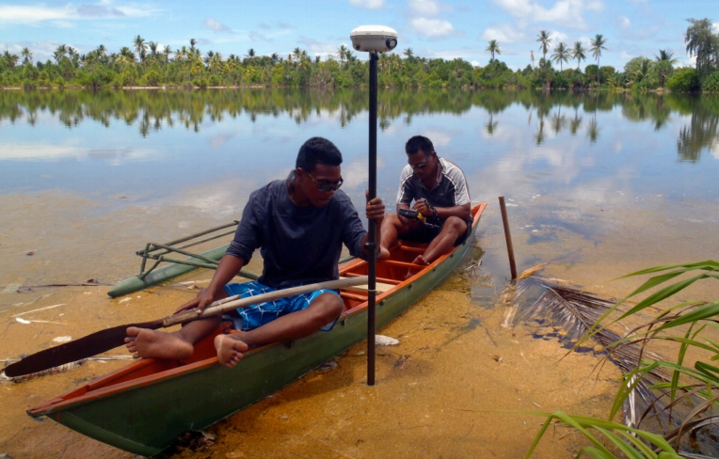
Main challenges and/or obstructions
Limitation in capacity to meet mapping authority standards (IHO/PCA)/carry out surveys
No legislation/policy framework in place to support hydrographic activities
Funding and financial constraints

Slide 9
Progress on surveys, charting and MSI
Surveys:
Plans to conduct hydrographic surveys on selected (Government priorities) islands (funded by the world bank)
Charting:
- BA 729 (Betio Anchorage) has been updated through UKHO however this needs to be further revised
- Gave authorization to UKHO to conduct satellite derived bathymetry (SDB) survey in Kiribati.
MSI:
There were some “H Notes” been sent to UKHO for chart corrections. On BA Chartb729.
Notes:
Betio (main port)
‘H’ note, hydrographic note – SPC
No surveys have been made in Kiribati; however there is a plan for doing an hydrographic surveys on Kiribati Government Priority areas in the outer islands in Kiribati this year 2019, funded by World Bank and Asian Development Bank. This will also include surveying for the rest of the Kiribati Islands.
can further explain this further

Slide 10
Progress on MSDI
Governance – no policy in place to support MSDI
Standards – no standards of practice that supports data collection, distribution
Technology – no infrastructure in place; hardware and software requirements can be met; matter of prioritization
Data – data is fragmented; data held within each Ministry; no set standards for data acquisition, storage and handling (e.g. metadata, updating data).

Slide 11
Plans that affect the region
Hydrographic surveys of Kiribati waters (funded by WDB and ADB)

Slide 12
Lessons learned to share
Expanding and allocating roles and duties
The importance of having legislation and polices in place
Support from high level officials is essential
Notes:
Marine Division – consisted of 5 people – The Director and two marine Officers, and of course the support staff
It has expanded and has over:
3 Units:
Quality Management
ATON
Safety of Life Sea (MSI)
Hydrographic
10+staff including support staff and registry – expand over the coming years – recruitment of staff in the coming – hydrographic unit

Slide 13
Thank you!
Questions?
Notes:
Thanks!

